Slide 1

Intel Image Classification
Presented to: Prof. Yousef Hussien Presented by: Mallikarjun E

Slide 2

Contents
Dataset Overview
Pre Processing
Model Architecture
Train and Optimize
Prediction
Evaluation
Improvements

Slide 3
Dataset Overview
This Dataset is about Scene Classification and is a part of Intel Image Classification from Analytics Vidhya - Data hack Competition.
6 Classes
14K Images – Train
3K Images – Validation
7K Images - Prediction

Slide 4
Pre Processing
Considered general Preprocessing techniques for Image Transformation
Resizing (150*150)
Random Horizontal Flip
ToTensor 0 - 255 to 0-1
Normalize – Mean and Standard Deviation
Data Loader

Slide 5
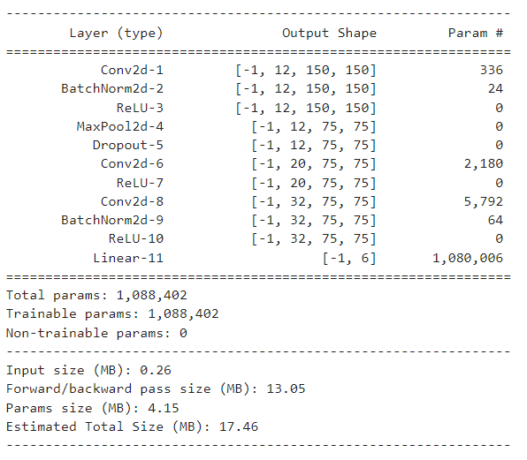
Model Architecture
Convolutional Layers - BCHW
Batch Normalization
Activation Layers
Max Pooling
Fully Connected layer
Dropout Layer

Slide 6
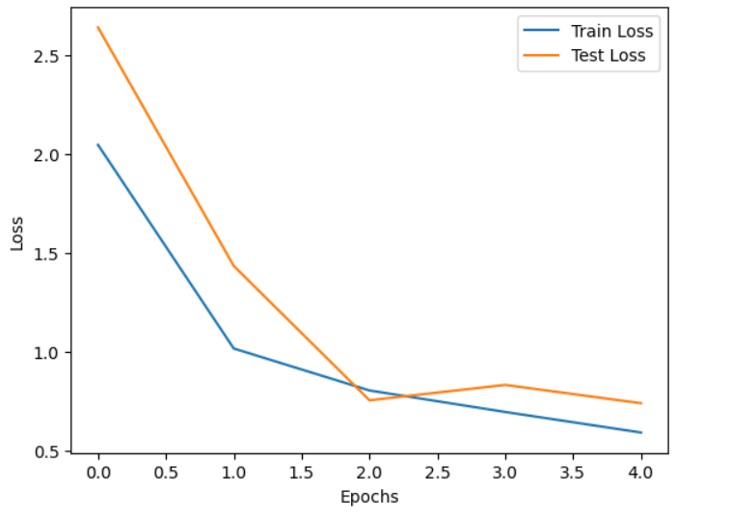
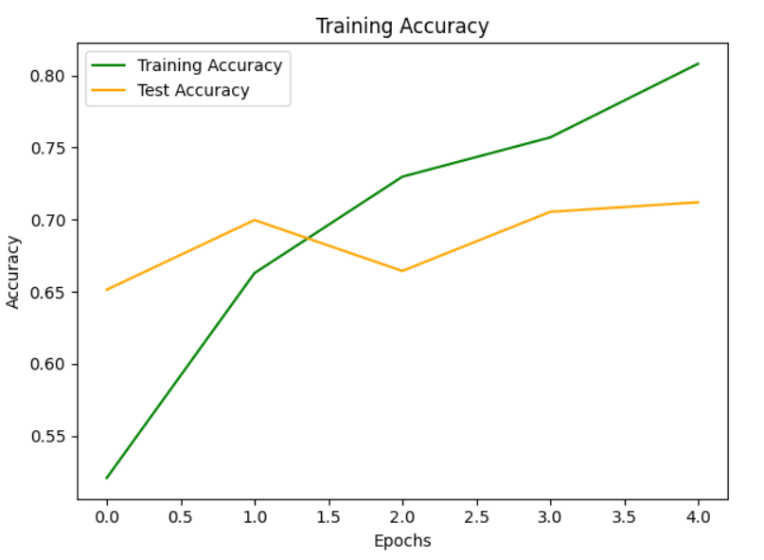
Train and Optimize
Stochastic Gradient Descent
Cross Entropy Loss

Slide 7
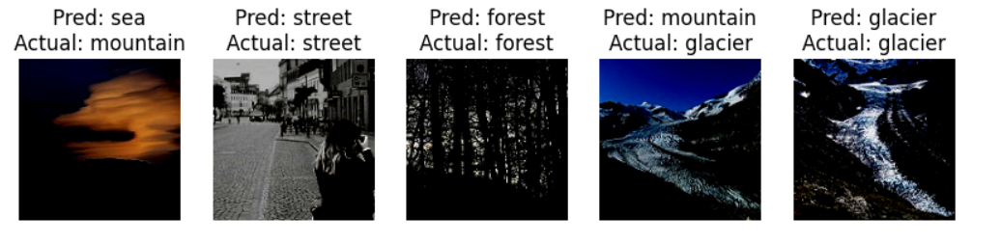
Prediction

Slide 8
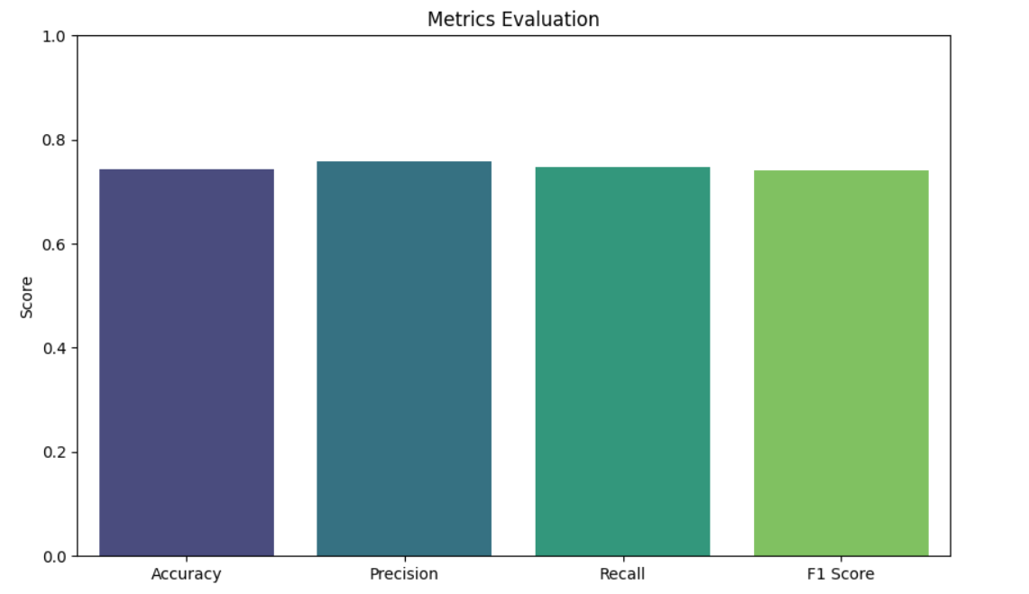
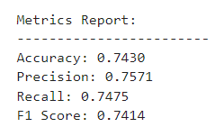
Evaluation

Slide 9
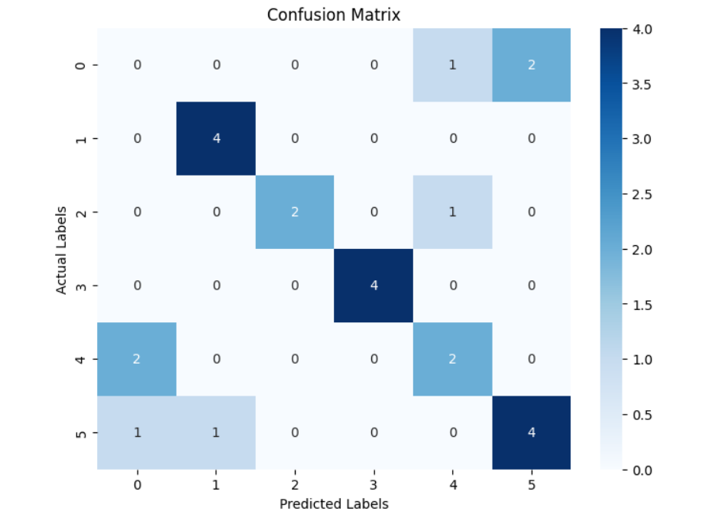

Confusion Matrix

Slide 10
Challenges and Improvement
Data Loading, Splitting
Over Fitting
Hyper Parameter Tuning - Code Integration
Trying out Pre-Trained Models

Slide 11
Thank You!

